Slide 1
Mandarin
Daina Goldenberg
HONORS 394: Language That Binds Us

Slide 2
Language Status
Status Level 1
840,000,000 speakers in China (70% L1)
Northern, Northwestern, Southwestern, Eastern/Lower Yangtze River
Sources: UCLA, Ethnologue

Slide 3
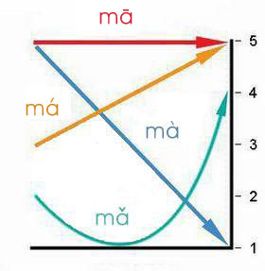
Language Characteristics
Sino-Tibetan language family
Logographs, pictographs, ideographs, compound ideographs, loan characters, phonetic compounds
Pinyin
Tone
Inflectional Morphemes
Pronouns
Source: UCLA
Image: http://www.theworldofchinese.com/wp-content/uploads/2012/09/tone_in-text.jpg

Slide 4
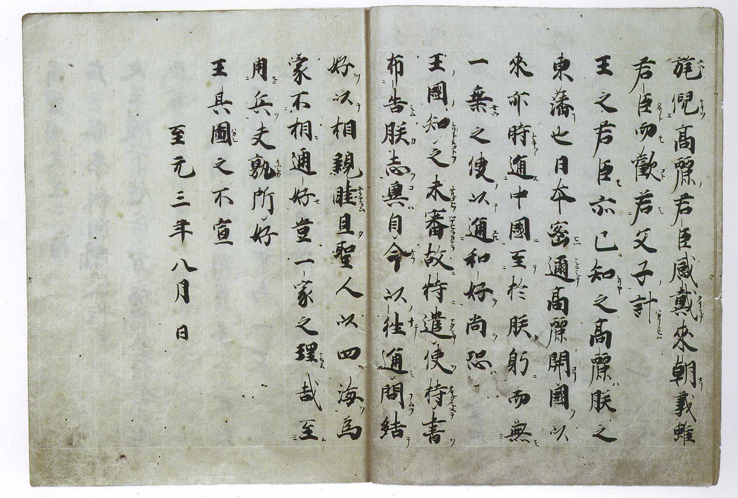
A Little History
Pre-classical
Classical
Post-classical
Source: UCLA
Image: http://upload.wikimedia.org/wikipedia/commons/e/e2/LetterFromKhubilaiToJapan1266.jpg

Slide 5
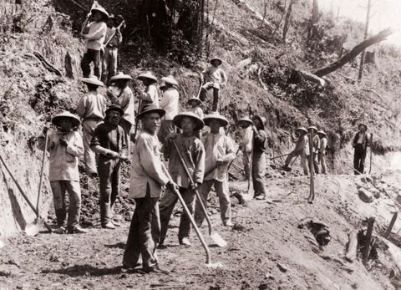
Chinese Immigration to PNW
Gold Rush 1950s
Transcontinental Railroad
Chinese Exclusion Act 1882
1885 Knights of Labor
1886 Attempted Expulsion
1943 Chinese Exclusion Act Repealed
WWII
Population today
Source: Washington State Historical Society, CAPAA
Image: http://mediad.publicbroadcasting.net/p/kuer/files/201405/chinese-railroad-workers.jpg

Slide 6
Community Resources
Northwest Chinese School
Washington International School
  Summer Courses
  Pinyin, math, SAT prep, Computer Programming,
  Bilingual Summer Camp
  Bilingual/immersion preschool and childcare
  CSSA at UW
  Chinese Major/Minor Options at UW
Sources: Northwest Chinese School, Washington International School, CSSA, UW Asian Languages and Literature

Slide 7
Ideas in Writing Practices
“5 Common Differences between Chinese and English” – John Webster
“Contrastive Rhetoric” – Carolyn Matalene
“Perfect English” – Xin Xin

